Slide 1
Case Studies

Slide 2
Case studies
Real Time Sentiment Analysis
Stock Market Predictions

Slide 3
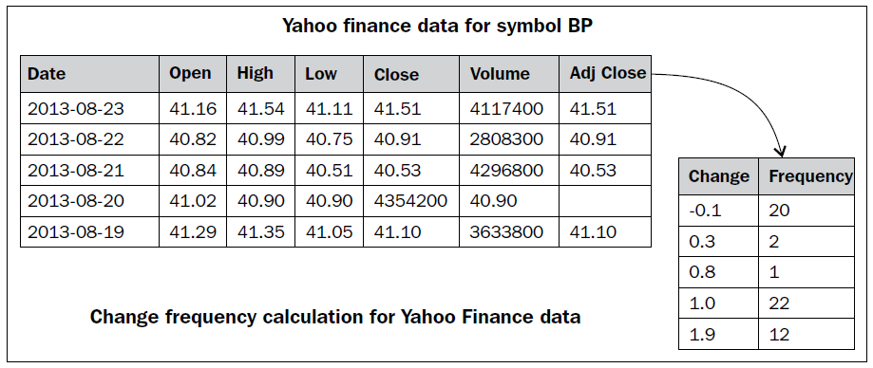
Stock Market Predictions
Computing the frequency of stock market change: This data analytics MapReduce problem is designed for calculating the frequency of stock market changes.
Identifying the problem
Since this is a typical stock market data analytics problem, it will calculate the frequency of past changes for one particular symbol of the stock market, such as a Fourier Transformation. Based on this information, the investor can get more insights on changes for different time periods. So the goal of this analytics is to calculate the frequencies of percentage change.

Slide 4
Designing data requirement
For this stock market analytics, we will use Yahoo! Finance as the input dataset.
We need to retrieve the specific symbol's stock information.
To retrieve this data, we will use the Yahoo! API with the following parameters:
From month
From day
From year
To month
To day
To year
Symbol

Slide 5
Preprocessing data
To perform the analytics over the extracted dataset, we will use R to fire the following command:
stock_BP <- read.csv("http://ichart.finance.yahoo.com/table.csv?s=BP")
or you can also download via the terminal:
wget http://ichart.finance.yahoo.com/table.csv?s=BP
#exporting to csv file
write.csv(stock_BP,"table.csv", row.names=FALSE)
Then upload it to HDFS by creating a speciic Hadoop directory for this:
# creating /stock directory in hdfs
bin/hadoop dfs -mkdir /stock
# uploading table.csv to hdfs in /stock directory
bin/hadoop dfs -put /home/Vignesh/downloads/table.csv /stock/

Slide 6
Performing analytics over data
To perform the data analytics operations, we will use streaming with R and Hadoop (without the HadoopStreaming package).
So, the development of this MapReduce job can be done without any RHadoop integrated library/package.
In this MapReduce job, we have defined Map and Reduce in different R files to be provided to the Hadoop streaming function.
From the following codes, we run MapReduce in R without installing or using any R library/package.
There is one system() method in R to fire the system command within R console to help us direct the firing of Hadoop jobs within R.
It will also provide the repose of the commands into the R console.

Slide 7
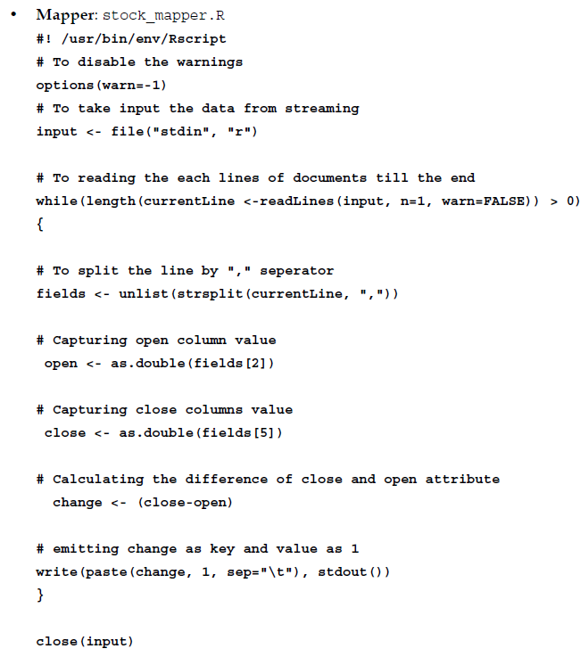
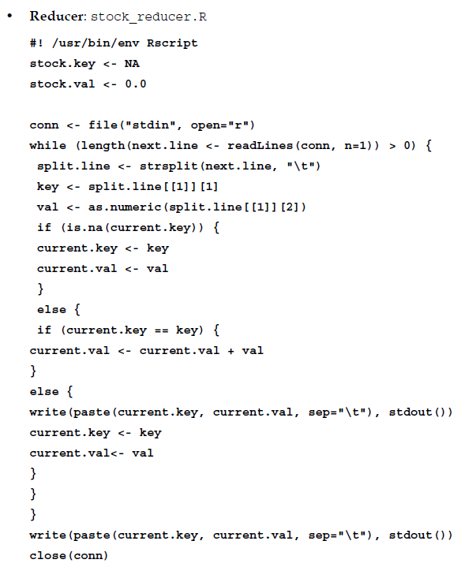

Slide 8
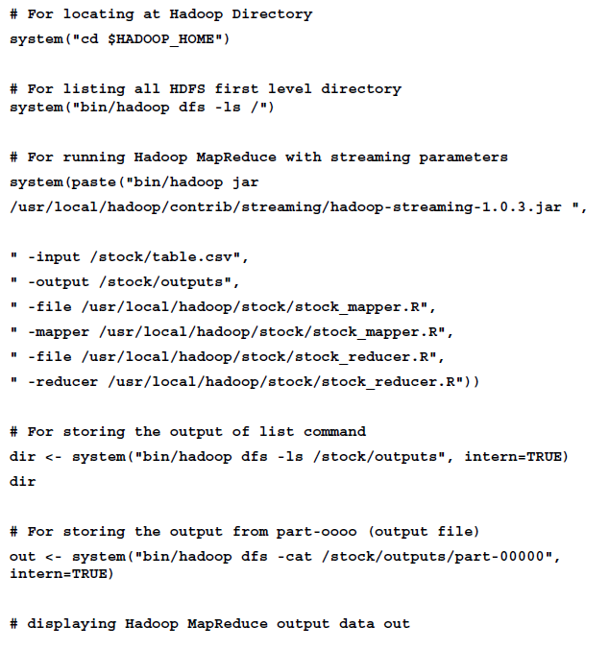
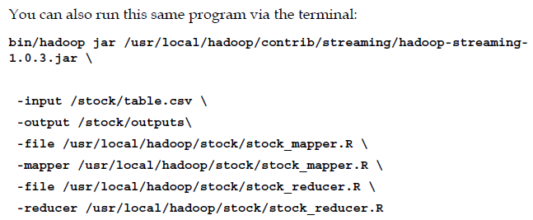

Slide 9
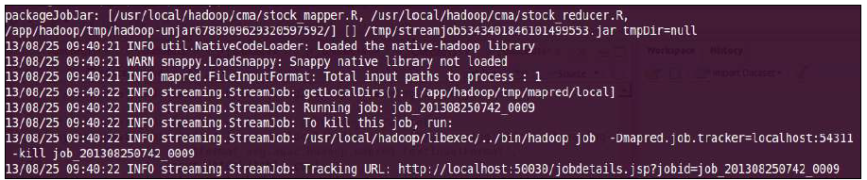
While running this program, the output at your R console or terminal will be as given in the following screenshot, and with the help of this we can monitor the status of the Hadoop MapReduce job.
Here we will see them sequentially with the divided parts.
Please note that we have separated the logs output into parts to help you understand them better.
The MapReduce log output contains (when run from terminal):
With this initial portion of log, we can identify the metadata for the Hadoop MapReduce job. We can also track the job status with the web browser, by calling the given Tracking URL. This is how the MapReduce job metadata is tracked.

Slide 10
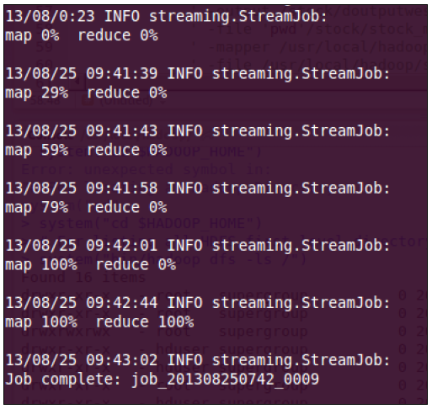
With this portion of log, we can monitor the status of the Mapper or Reducer tasks being run on the Hadoop cluster to get the details like whether it was successful or failed. This is how we track the status of the Mapper and Reducer tasks.

Slide 11
Once the MapReduce job is completed, its output location will be displayed at the end of the logs. This is known as tracking the HDFS output location.
From the terminal, the output of the Hadoop MapReduce program can be called using the following command:
bin/hadoop dfs -cat /stock/outputs/part-00000
The headers of the output of your MapReduce program will look as follows:
change frequency
The following figure shows the sample output of MapReduce problem:

Slide 12
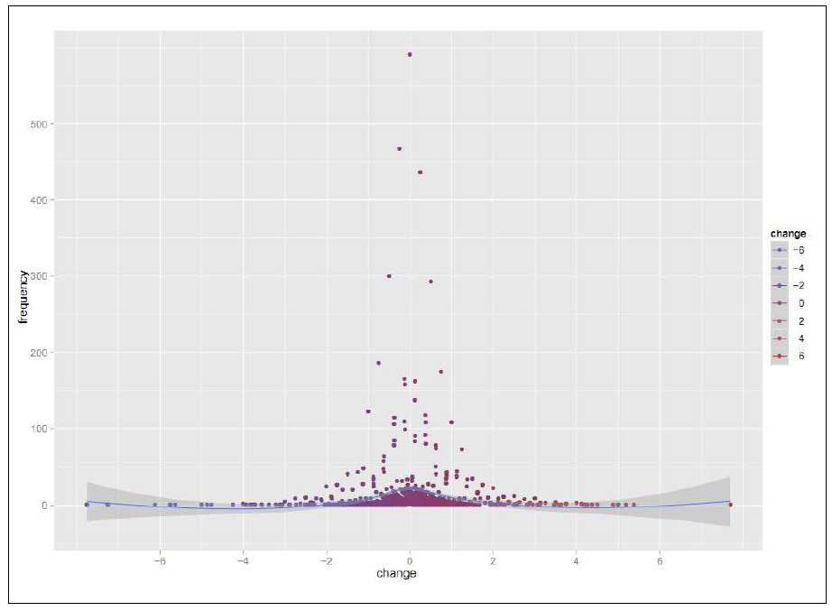
Visualizing data
We can get more insights if we visualize our output with various graphs in R.
Here, we have tried to visualize the output with the help of the ggplot2 package.

Slide 13
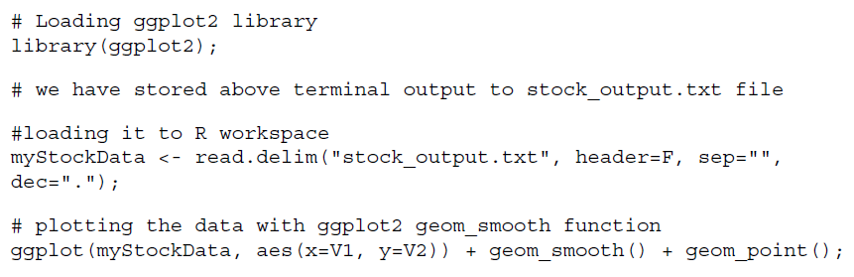
From the previous graph, we can quickly identify that most of the time the stock price has changed from around 0 to 1.5.
So, the stock's price movements in the history will be helpful at the time of investing.
The required code for generating this graph is as follows:

